Slide 1




Slide 2
Special Populations: MAOI, Homeless, Veterans

Slide 3


Slide 4
QAP Description
MHC has adopted the following criteria in which it will designate the discretionary basis boost:
Special Needs: Boost designation if it targets special needs populations. Special Needs developments are limited to developments that target:
  Elderly
  Homeless: As defined by the McKinney-Vento Homeless Act, HUD 42 U.S.Code §11302,
    Youth
  MAOI,
  Veterans

Slide 5
Reaching the population

Slide 6

MAOI and CHOICE
Creating Housing Opportunities in Communities for Everyone

Slide 7
What is
CHOICE: A bridge to rental subsidy for persons who are unstably housed and diagnosed with Serious Mental Illness (SMI)
  It provides permanent supportive housing to individuals with disabilities as a community-based alternative to hospitals, nursing facilities and other segregated settings.
CHOICE is a partnership between Mississippi Department of Mental Health and Mississippi Home Corp
CHOICE is targeted to individuals discharged from State Hospitals and CSUS and those referred by Community Mental Health Centers who meet the criteria for CHOICE housing vouchers.

Slide 8
House Bill 1563
Passed in 2015
Funds were appropriated to target:
Individuals with Disabilities (Mental)
OR
Individuals with Serious Mental Illnesses

Slide 9



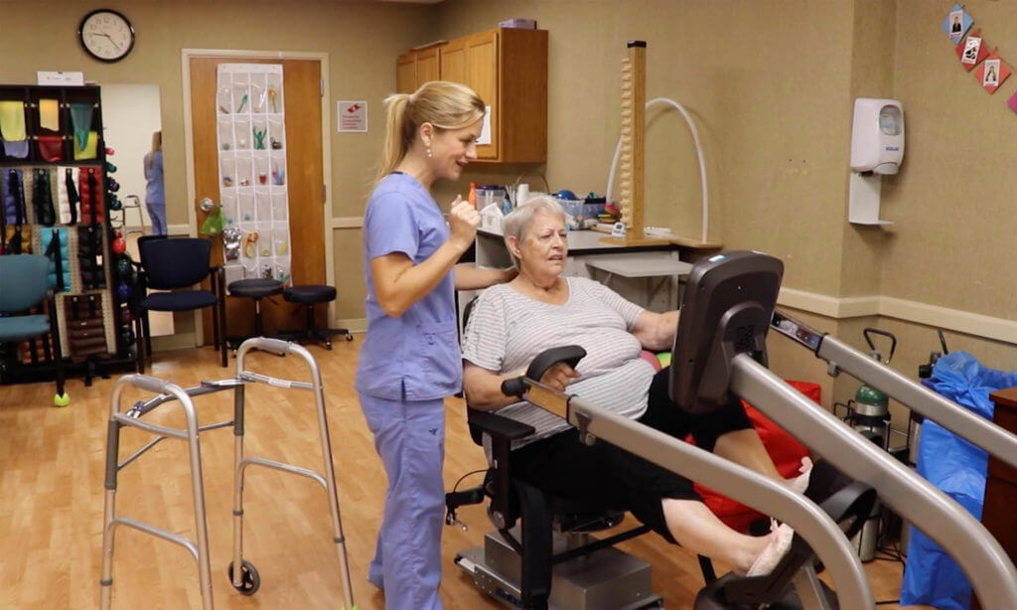


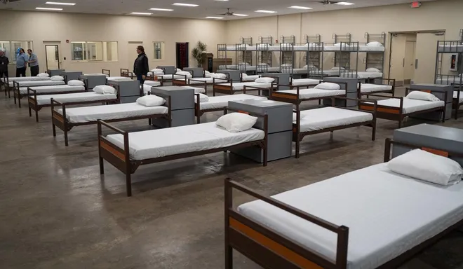

House Bill 1563, Section 4 (1)
Mentally Disabled
Serious Mental Illness
Category 1
Category 2
Category 3
90 Days
2 Years

Slide 10

Mississippi Olmstead Initiative
Individuals diagnosed with a serious mental illness (SMI) and are prioritized by one or more of the criteria identified by CHOICE.
Points are awarded to Tax Credit developments that set aside a minimum of 10%, but not more than 20% of the total development units for persons targeted by the initiative.
The owner must agree to accept referrals from the initiative referral network and execute an MOU (Memorandum of Understanding) between the owner/management entity and the agency.
Notes:
This brought around the Mississippi Olmstead Initiative and the CHOICE program

Slide 11
What is
Funded by appropriation from State of Mississippi
  Mississippi Home Corporation administers the funds and are responsible for assuring the appropriate use of funds in accordance with legislation and funding
  Mississippi Department of Mental Health approves client eligibility and verification of SMI
Is a component of the Mississippi Affirmative Olmstead Initiative addressing the state’s obligations under the Supreme Court’s Olmstead decision
  Olmstead vs L.C. case
CHOICE offers mental health support services and case management to participants
CHOICE assist participants with identifying housing and ongoing housing support, if needed.
CHOICE tracks data to determine program’s impact.

Slide 12
House Bill 1563, Section 4 (1)
Must meet one (1) of three (3) criteria:
  Criteria 1
  Individual is being discharged from:
    *State psychiatric hospital, or
    Nursing facility, or
    *Intermediate Care Facility (for individuals with intellectual disabilities)
  *Individual had to have stayed more than 90 days

Slide 13
House Bill 1563, Section 4 (1)
Must meet one (1) of three (3) criteria:
  Criteria 2
  Individual has been discharged from a State Psychiatric Hospital within the last two (2) years AND:
    Had multiple hospital visits in the last year due to mental illness; or
    Are known to the mental health or state housing agency to have been arrested or incarcerated in the last year due to conduct related to mental illness; or
    Are known to the mental health or state housing agency to have been homeless for one full year or have had four (4) or more episodes of homelessness in the last three (3) years.

Slide 14
House Bill 1563, Section 4 (1)
Must meet one (1) of three (3) criteria:
  Criteria 3
  Individual lacks a fixed, regular, and adequate nighttime residence and includes a subset for an individual who is exiting an institution where he/she resided for 90 days or less and who resides in an emergency shelter or a place not meant for human habitation immediately before entering that institution.

Slide 15
Funding
$13.376.954
2015-2023 FY
$1,810,227.00
MHC funding

Slide 16
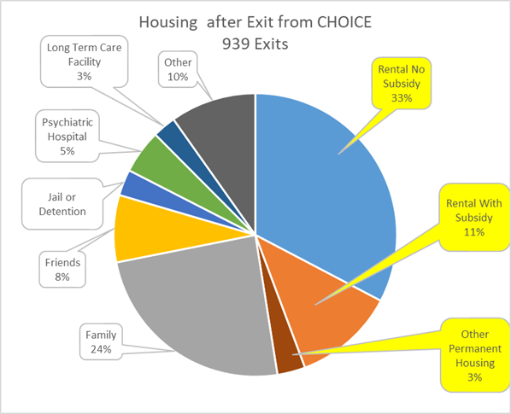
YTD 2024 report

Slide 17
MHC’s Goals
Provide assistance to approximately 50 clients per month
Case Manage clients to self sufficient
Provide affordable housing

Slide 18
Service Access
MHC funds four agencies to provide CHOICE housing services throughout the state:
  SAFE
  Community Counselling Services
  Grace House
  ODHC
Referrals:
  All referrals goes through ODHC
  Referrals can be made directly to ODHC or through DMH

Slide 19
Process Flow
Coordinated Entry and Referral from DMH approved applicants.
Housing Eligibility and Housing Navigation
Housing Stability

Slide 22
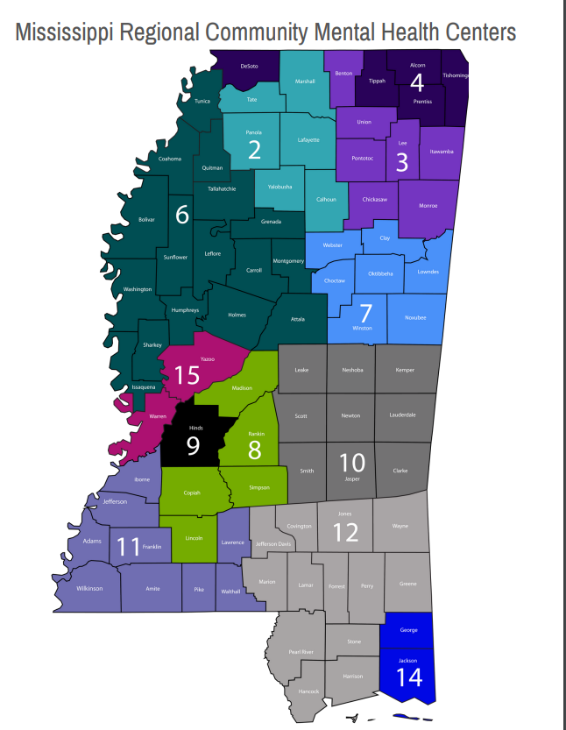
DMH
Community Mental Health Regional Map

Slide 23
DMH Crisis Contact list by Regions
CMHC | Name | Office Number | Cell Number | Agency Crisis Number | Email Address
Region 2 | Staci Waites | 662-234-7521 | 662-816-8460 | 866-837-7521 | swaites@oxfordcommunicare.com mmadaris@oxfordcommunicare.com
Region 3 | Mary Stacy | 662-640-4595 | 662-871-1809 | 866-255-9986 | mstacy@lifecorehealthgroup.com
Region 4 | Catherine Davis | 662-449-1971 | 901-262-9688 | 888-287-4443 | catherine.davis@regionivmhs.com
Region 6 | Keturah Brown | 662-289-4735 | 662-582-6985 | 866-453-6216 | keturahbrown@region6-lifehelp.org
Region 6 Tunica, Coahoma, Quitman, and Tallahatchie | Keturah Brown | 662-627-7267 | 662-582-6985 | 888-404-8002 | keturahbrown@region6-lifehelp.org
Region 7 | Chiquita Holmes | 662-573-4445 | 662-295-5947 | 888-943-3022 | Cholmes@ccsms.org
Region 8 | Scott Sumrall | 601-824-0342 | 601-259-3996 | 877-657-4098 | ssumrall@region8mhs.org
Region 9 | Jamie Evans | 601-321-2493 | 769-233-4634 | 601-955-6381 | jevans@hbhs9.com
Region 10 | Adetura Taylor | 601-483-4821 | 601-880-9069 | 800-803-0245 | ataylor@weemsmh.com
Region 11 | Michael Bowman | 601-684-2173 | 601-757-0097 | 877-353-8689 | mbowman@swmmhc.org
Region 12 | Connie Bienvenu | 601-544-4641 ext. 137 | 601-818-2755 601-596-2083 | 888-330-7772 | Connie.Bienvenu@pbmhr.org
Region 12 Coast area | Connie Bienvenu | 601-544-4641 ext. 137 | 601-818-2755 601-596-2083 | 800-681-0798 | Connie.Bienvenu@pbmhr.org
Region 14 George, Jackson counties | Linda Bradley | 228-497-0690 x 2811 | 228-627-7393 228-217-0053 | 866-497-0690 | lbradley@singingriverservices.org bfenech@singingriverservices.org
Region 15 | Jeanine Hanks | 601-638-0031 ext. 3653 | 601-218-2281 | W 601-638-0031 662-746-5712 1-888-558-2077 | jhanks@warren-yazoo.org

Slide 24
Location of Residence

Slide 25

Available Assistance
Rental: 12 months of assistance – can be extended 3 months
  Tenants pay 15% of income towards the rent if any
Rental application fee
Rental security deposit
Rental arrears
Utility deposit
Utility arrears
Furniture
Moving cost
Case management

Slide 26
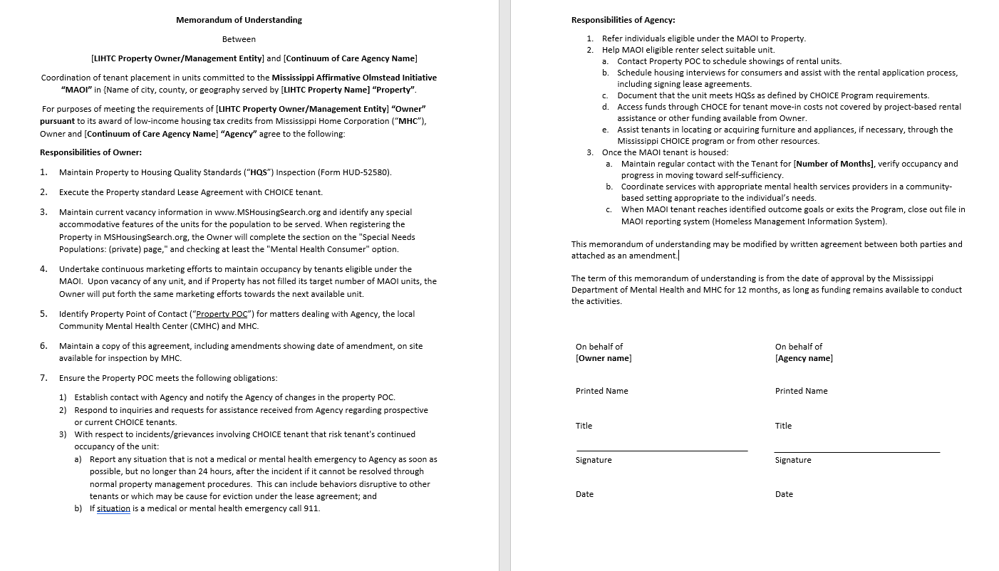
Sample MOU

Slide 27
RESPONSIBILITIES OF AGENCY
Refer individuals eligible under MAOI (CHOICE clients) to the property
Assist client to select available unit - contact property to schedule showing of unit; inspect property; assist with rental application process and signing of lease; access funds for tenant move in costs; assist tenant with acquiring furniture through CHOICE program or from other resources
Once the tenant is housed – maintain regular contact with tenant, verify occupancy, and progress in moving toward self-sufficiency; coordinate case management in a community-based setting appropriate to the individual’s needs

Slide 28
RESPONSIBILITIES OF OWNER
Undertake continuous marketing efforts to maintain occupancy by tenants eligible under MAOI
Upon vacancy of any unit and if the property has not filled its target number of MAOI units, then the owner shall put the same marketing efforts toward the next available unit and notify housing agent of the vacancy.
MAOI eligible applicants shall have preference over any individuals who are on a waiting list.
Maintain property to comply with HQS inspection

Slide 29
RESPONSIBILITIES OF OWNER
Identify property point of contact for matters dealing with agency, CMHC, and MHC
Respond to inquiries received from agency regarding prospective CHOICE tenants
Complete HAP Contract
Execute lease agreement with CHOICE tenant
Report any situations/incidents to agency; if it is a medical emergency, call 911; if it is a mental health emergency, call mobile crisis or ask the housing agency to call mobile crisis.

Slide 30

Homeless Population

Slide 31



As defined by the McKinney-Vento Homeless Act, HUD 42 U.S.Code §11302
Homeless Definitions
Category 1
Category 2
Category 4

Slide 32
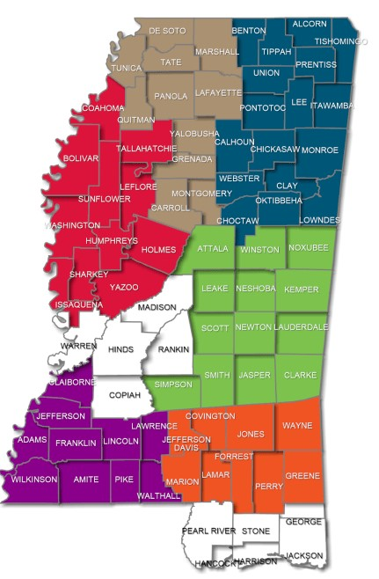
Continuum of Cares
MS has 3 CoCs
  Balance of State CoC
  Central CoC
  ODHC CoC
Each CoC manages a referral system called the Coordinated Entry Referral System (CES)

Slide 33
2023 PIT Homeless Count
Veterans
  Mississippi- 61
    Central CoC- 27
    BoS CoC- 23
    Gulf Coast CoC- 11
Homeless
  Mississippi- 982
    Central CoC- 315
    BoS CoC- 412
    Gulf Coast CoC- 255

Slide 34
Coordinated Entry Referrals List
Homeless
Veterans
MAOI

Slide 35
Compliance and Documentation

Slide 36
COMPLIANCE REQUIREMENTS
Applicant must be the Head Of Household / Individual Adult (2024 HTC Award)
Applicant’s income - 30% or less of the AMI.
Minimum required special needs unit obligation must be met by the end of the initial lease-up period.
Developments must maintain the minimum number of special needs units indefinitely.
Copy of the MOU, if the partnership changes at any point

Slide 37
COMPLIANCE DOCUMENTATION - MAOI
Requirement Met:
  Referral Form (Referral Network Partner listed in the HTC Application)
    Should be included in the Tenant’s Application File
Requirement NOT Met:
  Documentation from Referral Network Partner stating that no referrals were available
    Letters/emails/correspondence
    Must be provided to the owner during 30-day marketing;
    Dated – for a specific timeframe
    Submitted with the quarterly/annual reports; upon request

Slide 38
COMPLIANCE DOCUMENTATION - Veterans
Defined as a household that includes one or more persons that is eligible for Veterans benefits as documented by the U.S. Dept. of Veterans Affairs.
Requirement Met:
  Veteran Affairs Letter
  Veterans ID
  Form DD214 (Long Version)
Requirement NOT Met:
  Documentation from the Veteran Affairs Hospital / Community-based Outreach Clinic stating that no referrals were available
    Letters/emails/correspondence
    Must be provided to the owner during 30-day marketing;
    Dated – for a specific timeframe
    Submitted with the quarterly/annual reports; upon request

Slide 39
MARKETING OUTREACH REQUIREMENTS
  Upon vacancy, the Public Housing Authority in the area must be notified.
  Must actively market any vacant units first to the targeted special-needs population for 30 days.
  30-Day Period: begins - ready for occupancy / qualifying person(s) has vacated the unit.
  Repeats at each vacancy until requirement is met.

Slide 40
MARKETING OUTREACH DOCUMENTATION
  Community Notifications (Newspaper Ads/Flyers):
    Identify the Targeted Population
    Publication Name
    Date
    Development’s Name
    Contact Person Info. (contact person’s name, phone number, & address)
    Circulated in the area of the development and/or frequently visited places by the targeted population

Slide 41
MARKETING DOCUMENTATION cont.
  Waiting List
  Tenant Selection Plan
  Any Rejected Applications
  Special Needs Housing Log

Slide 42
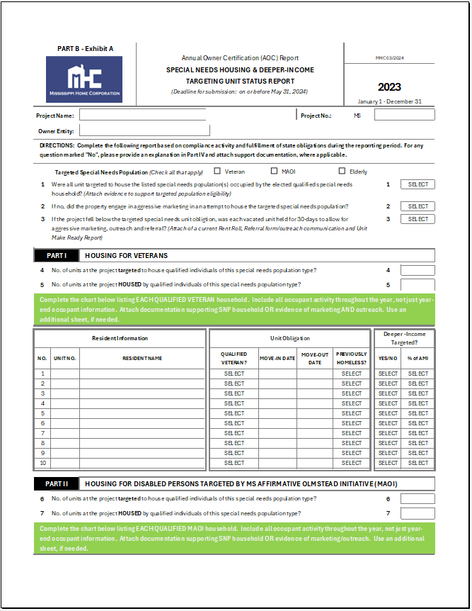
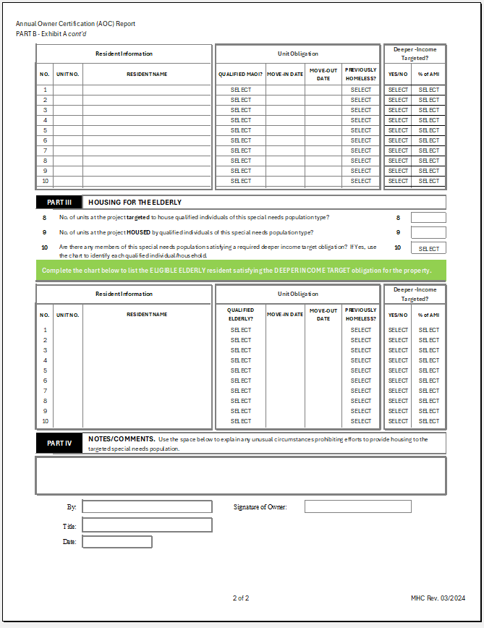
Special Needs Housing Log – Rev. 2024

Slide 43
Noncompliance:
(Failure to meet Special Needs Set-Aside)
  Not an 8823 reportable event;
  Serious state noncompliance event, which can lead to program suspension/disbarment.

Slide 44
Youth
Will be discussed in detail at our next session

Slide 45

Questions

Slide 46
Contacts:
MHC
  Brandon Morey: brandon.morey@mshc.com
  Apiphany Smith: apiphany.smith@mshc.com
  Tamara Stewart: tamara.stewart@mshc.com
ODHC
  Dr. Dena Wittmann: dwittmann@opendoorshc.org

Slide 47


